Slide 1
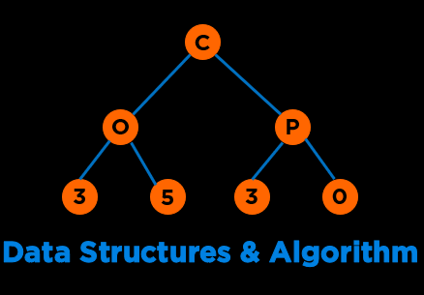
Lists, Stacks and Queues
Notes:
Hi everyone, welcome to the second module of the course

Slide 2
Categories of Data Structures
Linear Ordered
Non-linear Ordered
Not Ordered
Lists
Trees
Sets
Stacks
Graphs
Tables/Maps
Queues
Notes:
Data structures are ways to collect data. There are basic categories of data structures:

Slide 3
Agenda
Data Structures
Abstract Data Types
Lists
Array Implementation
Linked List Implementation and its types
Lists in C++
Stacks
Array Based and Linked List Based
Stacks in C++
Use Cases
Queues
Array Based and Linked List Based
Queue in C++
Use cases
Notes:
Discussed, touched upon, went over, covered
Emerges out of the limitations offered by our second approach

Slide 4
Data Structures
Notes:
But what do we truly care about?

Slide 5
Data Structures
A data structure is a way to store and organize data
Mathematical or Logical models (Abstract Data Types)
List: Store, Read, Modify
Implementation (Concrete)
Arrays, Linked List, Vector, ArrayList, List
Notes:
Data structures are ways to collect data. There are basic categories of data structures:

Slide 6
Abstract Data Types
Notes:
But what do we truly care about?

Slide 7

Abstract Data Types
Class of objects whose logical behavior is defined by a set of values and a set of operations
Define data (properties) and operations (behavior)
Don’t care about implementation
https://en.wikipedia.org/wiki/Abstract_data_type
Notes:
Data structures are ways to collect data. There are basic categories of data structures:

Slide 8
Abstract Data Types (ADTs)
ADTs
Conceptual Understanding
Problem Solving
Operations & Performance
Notes:
Psuedocode and code

Slide 9
Lists
Notes:
But what do we truly care about?

Slide 10
List
Ordered Collection of Data (Ordered = Position)
Elements have some position
Linear Structure
Can have some size or grow/shrink
No limit on nature of elements
Notes:
Data structures are ways to collect data. There are basic categories of data structures:

Slide 11
List - Characteristics
Data
Operations
Notes:
Data structures are ways to collect data. There are basic categories of data structures:

Slide 12
List - Characteristics
Data
Items
Number of Items (Size)
Capacity
Operations
Read/Write an element
Add or remove an element
Find an element
Count
Traverse the list (Printing)
Notes:
Data structures are ways to collect data. There are basic categories of data structures:

Slide 13
List – Example: Array
Characteristics | Fixed Size Stores Similar Elements Contiguous Indices Elements are stored contiguously in memory Allows Random Access
Operations
Performance
Benefits
Drawbacks
Notes:
Data structures are ways to collect data. There are basic categories of data structures:

Slide 14
List – Example: Array
Characteristics | Fixed Size Stores Similar Elements Contiguous Indices Elements are stored contiguously in memory Allows Random Access
Operations
Performance
Benefits
Drawbacks
Notes:
Data structures are ways to collect data. There are basic categories of data structures:

Slide 15
List – Example: Array
Characteristics | Fixed Size Stores Similar Elements Contiguous Indices Elements are stored contiguously in memory Allows Random Access
Operations | Adding – Beginning, Middle, End Removal – Beginning, Middle, End
Performance |  | Add | Remove
 | Beginning
 | End
 | Middle
Benefits
Drawbacks
Notes:
Data structures are ways to collect data. There are basic categories of data structures:

Slide 16
List – Example: Array
Characteristics | Fixed Size Stores Similar Elements Contiguous Indices Elements are stored contiguously in memory Allows Random Access
Operations | Adding – Beginning, Middle, End Removal – Beginning, Middle, End
Performance |  | Add | Remove
 | Beginning | O(n) | O(n)
 | End | O(1) | O(1)
 | Middle | O(n) | O(n)
Benefits
Drawbacks
Notes:
Data structures are ways to collect data. There are basic categories of data structures:

Slide 17
List – Example: Array
Characteristics | Fixed Size Stores Similar Elements Contiguous Indices Elements are stored contiguously in memory Allows Random Access
Operations | Adding – Beginning, Middle, End Removal – Beginning, Middle, End
Performance |  | Add | Remove
 | Beginning | O(n) | O(n)
 | End | O(1) | O(1)
 | Middle | O(n) | O(n)
Benefits | Constant Access Time, arr[i] = arr + (i*sizeOf(type))
Drawbacks
Notes:
Data structures are ways to collect data. There are basic categories of data structures:

Slide 18
List – Example: Array
Characteristics | Fixed Size Stores Similar Elements Contiguous Indices Elements are stored contiguously in memory Allows Random Access
Operations | Adding – Beginning, Middle, End Removal – Beginning, Middle, End
Performance |  | Add | Remove
 | Beginning | O(n) | O(n)
 | End | O(1) | O(1)
 | Middle | O(n) | O(n)
Benefits | Constant Access Time, arr[i] = arr + (i*sizeOf(type))
Drawbacks | Expensive for adding/removing elements from front
Notes:
Data structures are ways to collect data. There are basic categories of data structures:

Slide 19
List – Example: Single Linked List
Notes:
Data structures are ways to collect data. There are basic categories of data structures:

Slide 20
List – Example: Single Linked List
class Node
{
public:
Node *next;
int data;
};
int main ()
{
Node* obj = new Node;
obj -> data = 10;
obj -> next = nullptr;
obj -> next = new Node;
obj -> next -> data = 20;
obj -> next -> next = nullptr;
obj -> next -> next = new Node;
obj -> next -> next -> data = 30;
obj -> next -> next -> next = nullptr;
return 0;
}
Notes:
Data structures are ways to collect data. There are basic categories of data structures:

Slide 21
List – Example: Single Linked List
class Node
{
public:
Node *next;
int data;
};
int main ()
{
Node* obj = new Node;
obj -> data = 10;
obj -> next = nullptr;
obj -> next = new Node;
obj -> next -> data = 20;
obj -> next -> next = nullptr;
obj -> next -> next = new Node;
obj -> next -> next -> data = 30;
obj -> next -> next -> next = nullptr;
return 0;
}
Problem:
Messy and too hard to read, Error prone
Notes:
Data structures are ways to collect data. There are basic categories of data structures:

Slide 22
List – Example: Single Linked List
class Node
{
public:
Node *next;
int data;
Node(int d, Node* n);
private:
int size();
};
Node::Node(int d, Node* n)
{
this -> data = d;
this -> next = n;
}
int Node::size()
{
if(this == nullptr)
return 0;
else
return 1 + (this->next)->size();
}
int main ()
{
Node* obj = new Node(10, nullptr);
obj = new Node(20, obj);
obj = new Node(30, obj);
cout << "Size = "<< obj -> size();
return 0;
}
https://onlinegdb.com/rk6AxHfsU
Notes:
Data structures are ways to collect data. There are basic categories of data structures:

Slide 23
List – Example: Single Linked List
class Node
{
public:
Node *next;
int data;
Node(int d, Node* n);
private:
int size();
};
Node::Node(int d, Node* n)
{
this -> data = d;
this -> next = n;
}
int Node::size()
{
if(this == nullptr)
return 0;
else
return 1 + (this->next)->size();
}
int main ()
{
Node* obj = new Node(10, nullptr);
obj = new Node(20, obj);
obj = new Node(30, obj);
cout << "Size = "<< obj -> size();
return 0;
}
Problem:
Too much details
https://onlinegdb.com/rk6AxHfsU
Notes:
Data structures are ways to collect data. There are basic categories of data structures:

Slide 24
List – Example: Single Linked List
Encapsulate Node: Better Design
struct Node
{
int data;
Node *next;
};
or
class Node
{
public:
Node *next;
int data;
};
class List
{
public:
int size;
Node* head;
Node* tail;
public:
List();
void push_front(int);
};
Notes:
Data structures are ways to collect data. There are basic categories of data structures:

Slide 25
List – Example: Single Linked List
Encapsulate Node: Better Design
struct Node
{
int data;
Node *next;
};
or
class Node
{
public:
Node *next;
int data;
};
class List
{
public:
int size;
Node* head;
Node* tail;
public:
List();
void push_front(int);
};
List::List()
{
size = 0;
head = new Node;
tail = new Node;
head -> next = tail;
}
void List::push_front(int x)
{
Node* temp = new Node;
temp -> data = x;
temp -> next = head->next;
head -> next = temp;
size++;
}
int main()
{
List obj;
obj.push_front(15);
obj.push_front(20);
obj.push_front(15);
return 0;
}
Notes:
Data structures are ways to collect data. There are basic categories of data structures:

Slide 26
List – Example: Single Linked List
Do not expose internal details to the client
int main()
{
List myList;
myList.push_front(15);
myList.push_front(20);
myList.push_front(15);
return 0;
}
Notes:
Data structures are ways to collect data. There are basic categories of data structures:

Slide 27
List – Example: Single Linked List
Characteristics | Consists of Nodes Data Pointer to Next Node Stores Similar Elements Elements are linked in memory but stored non-contiguously Does not allow Random Access
Operations | Adding (Add) – PushFront(Key), PushBack(Key) Removal (Remove) – PopFront, PopBack Access (Get) – TopFront, TopBack Find(Key), Erase(Key), Empty() AddBefore(Node, Key), AddAfter(Node, Key)
Performance | PushFront – O(1) | PushBack – O(n) | AddBefore – O(n)
 | PopFront – O(1) | PopBack – O(n) | AddAfter – O(1)
 | TopFront – O(1) | TopBack – O(n)
 | Find – O(n) | Erase – O(n) | Empty – O(1)
Benefits | Adding/Removing in front is faster, O(1)
Drawbacks | Expensive for random access, O(n) TopBack, PushBack, PopBack and AddBefore are expensive
Notes:
Data structures are ways to collect data. There are basic categories of data structures:

Slide 28
List – Example: Single Linked List
Characteristics | Consists of Nodes Data Pointer to Next Node Stores Similar Elements Elements are linked in memory but stored non-contiguously Does not allow Random Access
Operations | Adding (Add) – PushFront(Key), PushBack(Key) Removal (Remove) – PopFront, PopBack Access (Get) – TopFront, TopBack Find(Key), Erase(Key), Empty() AddBefore(Node, Key), AddAfter(Node, Key)
Performance | PushFront – O(1) | PushBack – O(n) | AddBefore – O(n)
 | PopFront – O(1) | PopBack – O(n) | AddAfter – O(1)
 | TopFront – O(1) | TopBack – O(n)
 | Find – O(n) | Erase – O(n) | Empty – O(1)
Benefits | Adding/Removing in front is faster, O(1)
Drawbacks | Expensive for random access, O(n) TopBack, PushBack, PopBack and AddBefore are expensive
Notes:
Data structures are ways to collect data. There are basic categories of data structures:

Slide 29
List – Example: Single Linked List
Characteristics | Consists of Nodes Data Pointer to Next Node Stores Similar Elements Elements are linked in memory but stored non-contiguously Does not allow Random Access
Operations | Adding (Add) – PushFront(Key), PushBack(Key) Removal (Remove) – PopFront, PopBack Access (Get) – TopFront, TopBack Find(Key), Erase(Key), Empty() AddBefore(Node, Key), AddAfter(Node, Key)
Performance | PushFront – O(1) | PushBack – O(n) | AddBefore – O(n)
 | PopFront – O(1) | PopBack – O(n) | AddAfter – O(1)
 | TopFront – O(1) | TopBack – O(n)
 | Find – O(n) | Erase – O(n) | Empty – O(1)
Benefits | Adding/Removing in front is faster, O(1)
Drawbacks | Expensive for random access, O(n) TopBack, PushBack, PopBack and AddBefore are expensive
Notes:
Data structures are ways to collect data. There are basic categories of data structures:

Slide 30
List – Example: Single Linked List
Characteristics | Consists of Nodes Data Pointer to Next Node Stores Similar Elements Elements are linked in memory but stored non-contiguously Does not allow Random Access
Operations | Adding (Add) – PushFront(Key), PushBack(Key) Removal (Remove) – PopFront, PopBack Access (Get) – TopFront, TopBack Find(Key), Erase(Key), Empty() AddBefore(Node, Key), AddAfter(Node, Key)
Performance | PushFront – O(1) | PushBack – O(n) | AddBefore – O(n)
 | PopFront – O(1) | PopBack – O(n) | AddAfter – O(1)
 | TopFront – O(1) | TopBack – O(n)
 | Find – O(n) | Erase – O(n) | Empty – O(1)
Benefits | Adding/Removing in front is faster, O(1)
Drawbacks | Expensive for random access, O(n) TopBack, PushBack, PopBack and AddBefore are expensive
Notes:
Data structures are ways to collect data. There are basic categories of data structures:

Slide 31
List – Example: Single Linked List
Characteristics | Consists of Nodes Data Pointer to Next Node Stores Similar Elements Elements are linked in memory but stored non-contiguously Does not allow Random Access
Operations | Adding (Add) – PushFront(Key), PushBack(Key) Removal (Remove) – PopFront, PopBack Access (Get) – TopFront, TopBack Find(Key), Erase(Key), Empty() AddBefore(Node, Key), AddAfter(Node, Key)
Performance | PushFront – O(1) | PushBack – O(n) | AddBefore – O(n)
 | PopFront – O(1) | PopBack – O(n) | AddAfter – O(1)
 | TopFront – O(1) | TopBack – O(n)
 | Find – O(n) | Erase – O(n) | Empty – O(1)
Benefits | Adding/Removing in front is faster, O(1)
Drawbacks | Expensive for random access, O(n) TopBack, PushBack, PopBack and AddBefore are expensive
Notes:
Data structures are ways to collect data. There are basic categories of data structures:

Slide 32
List – Example: Single Linked List
Characteristics | Consists of Nodes Data Pointer to Next Node Stores Similar Elements Elements are linked in memory but stored non-contiguously Does not allow Random Access
Operations | Adding (Add) – PushFront(Key), PushBack(Key) Removal (Remove) – PopFront, PopBack Access (Get) – TopFront, TopBack Find(Key), Erase(Key), Empty() AddBefore(Node, Key), AddAfter(Node, Key)
Performance | PushFront – O(1) | PushBack – O(n) | AddBefore – O(n)
 | PopFront – O(1) | PopBack – O(n) | AddAfter – O(1)
 | TopFront – O(1) | TopBack – O(n)
 | Find – O(n) | Erase – O(n) | Empty – O(1)
Benefits | Adding/Removing in front is faster, O(1)
Drawbacks | Expensive for random access, O(n) TopBack, PushBack, PopBack and AddBefore are expensive
Notes:
Data structures are ways to collect data. There are basic categories of data structures:

Slide 33
List – Example: Single Linked List
Characteristics | Consists of Nodes Data Pointer to Next Node Stores Similar Elements Elements are linked in memory but stored non-contiguously Does not allow Random Access
Operations | Adding (Add) – PushFront(Key), PushBack(Key) Removal (Remove) – PopFront, PopBack Access (Get) – TopFront, TopBack Find(Key), Erase(Key), Empty() AddBefore(Node, Key), AddAfter(Node, Key)
Performance | PushFront – O(1) | PushBack – O(n) | AddBefore – O(n)
 | PopFront – O(1) | PopBack – O(n) | AddAfter – O(1)
 | TopFront – O(1) | TopBack – O(n)
 | Find – O(n) | Erase – O(n) | Empty – O(1)
Benefits | Adding/Removing in front is faster, O(1)
Drawbacks | Expensive for random access, O(n) TopBack, PushBack, PopBack and AddBefore are expensive
Notes:
Data structures are ways to collect data. There are basic categories of data structures:

Slide 34
List : Single Linked List with Tail
Characteristics | Consists of Nodes and has a Tail Data Pointer to Next Node Stores Similar Elements Elements are linked in memory but stored non-contiguously Does not allow Random Access
Operations | Adding – PushFront(Key), PushBack(Key) Removal – PopFront, PopBack Access – TopFront, TopBack Find(Key), Erase(Key), Empty() AddBefore(Node, Key), AddAfter(Node, Key)
Performance | PushFront – O(1) | PushBack – O(1) | AddBefore – O(n)
 | PopFront – O(1) | PopBack – O(n) | AddAfter – O(1)
 | TopFront – O(1) | TopBack – O(1)
 | Find – O(n) | Erase – O(n) | Empty – O(1)
Benefits | Solves the issue of pushing back and getting last element
Drawbacks | Expensive for PopBack and AddBefore
Notes:
Data structures are ways to collect data. There are basic categories of data structures:

Slide 35
List : Doubly Linked List with Tail
Characteristics | Consists of Nodes Data Pointer to Next and Previous Node Stores Similar Elements Elements are linked in memory but stored non-contiguously Does not allow Random Access
Operations | Adding – PushFront(Key), PushBack(Key) Removal – PopFront, PopBack Access – TopFront, TopBack Find(Key), Erase(Key), Empty() AddBefore(Node, Key), AddAfter(Node, Key)
Performance | PushFront – O(1) | PushBack – O(1) | AddBefore – O(1)
 | PopFront – O(1) | PopBack – O(1) | AddAfter – O(1)
 | TopFront – O(1) | TopBack – O(1)
 | Find – O(n) | Erase – O(n) | Empty – O(1)
Benefits | Solves the issue of PopBack and AddBefore
Drawbacks | Extra memory
Notes:
Data structures are ways to collect data. There are basic categories of data structures:

Slide 36
List – Example: Circular Linked List
Single Circular
Doubly Circular
Notes:
Data structures are ways to collect data. There are basic categories of data structures:

Slide 37
Array vs Linked List: Space
Space
List size
Array implementation requires an estimate of the size when the list is created, or requires reallocation
Linked implementation can grow as needed
Element size
Array implementation requires storage of only the item
Linked implementation requires storage of the item and a pointer
Notes:
Data structures are ways to collect data. There are basic categories of data structures:

Slide 38
Array vs Linked List: Time
Time
Access
Array implementation allows constant time access to any index
Linked implementation requires stepping through the list to access an item
Adding and Removing
Array implementation requires elements to be moved
Linked implementation insertion or removal is constant time if the iterator is where you want it

Slide 39
Lists in C++ Standard Template Library
List ADT
Array
Vector
List
Forward_list
http://www.cplusplus.com/reference/stl/
Notes:
Psuedocode and code

Slide 40
Lists in C++ Standard Template Library
List ADT
Array
Vector
List
Forward_list
Fixed size
Single Linked List
Dynamic size
Doubly Linked List
http://www.cplusplus.com/reference/stl/
Notes:
Psuedocode and code

Slide 41
Lists in C++ STL: List
List containers are implemented as doubly-linked lists
Function | Operation
Constructor(n, val) | Constructs a container with n elements. Each element is a copy of val (if provided).
void push_front (val) | Inserts a new element at the beginning of the list, right before its current first element.
std::list<int> mylist (4,100);
mylist.push_front (200);
[100, 100, 100, 100]
[200, 100, 100, 100, 100]
http://www.cplusplus.com/reference/list/list/
Notes:
Psuedocode and code

Slide 42
Tips is due at 7 pm
Notes:
Track of progress, access to current and mechanism to next data element
Dereference operator to get the data

Slide 43
Lists in C++ STL: List
Printing a List
01 02 03 04
list<int> mylist (4,100); // [100, 100, 100, 100] mylist.push_front (200); // [200, 100, 100, 100, 100] for(list<int>::iterator it = mylist.begin(); it != mylist.end(); ++it) cout << ' ' << *it;
Prints: 200 100 100 100 100
All containers have Iterators!
http://www.cplusplus.com/reference/list/list/
Notes:
Track of progress, access to current and mechanism to next data element
Dereference operator to get the data

Slide 44
Iterators
Variables to keep track of where we are in a data set
Iterator Class
Operators to advance to next data (++)
Dereference Operator (*) to access data
Operators to compare two iterators (!=)
Assignment operator (=)
Container or the main data structure you are implementing Class
begin() methods
end() methods
Templated Singly Linked List: https://cathyatseneca.gitbooks.io/data-structures-and-algorithms/lists/list_declaration.html
Notes:
Track of progress, access to current and mechanism to next data element
Dereference operator to get the data

Slide 45
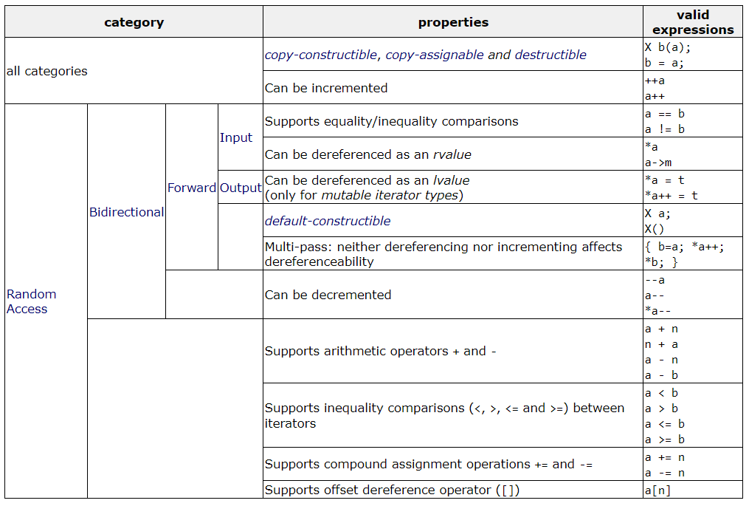
Iterators
http://www.cplusplus.com/reference/iterator/
Notes:
Psuedocode and code

Slide 46
Iterators: Forward
// Forward Lists - support forward iterators: https://www.cplusplus.com/reference/forward_list/forward_list/
std::forward_list<int> flist_container {1, 2, 3, 4, 5};
for(auto it = flist_container.begin(); it != flist_container.end(); it++)
{
std::cout << *it << std::endl;
std::cout << *(--it); //This line will throw an error as iterator does not support going backward
std::cout << *(it + 2); //This line will throw an error as iterator does not support random access
break;
}
https://onlinegdb.com/UpmaNAbTd
Notes:
Psuedocode and code

Slide 47
Iterators: Bidirectional
// Lists - support bidirectional iterators: https://www.cplusplus.com/reference/list/list/
std::list<int> list_container {1, 2, 3, 4, 5};
for(auto it = list_container.begin(); it != list_container.end(); it++)
{
std::cout << *it << " ";
std::cout << *(--it) << std::endl; //This line is undefined behavior
//std::cout << *(it + 2); //This line will throw an error as iterator does not support random access
break;
}
https://onlinegdb.com/UpmaNAbTd
Notes:
Psuedocode and code

Slide 48
Iterators: Random Access
// Vectors - support random access iterators: https://cplusplus.com/reference/vector/vector/
std::vector<int> vector_container {1, 2, 3, 4, 5};
for(auto it = vector_container.begin(); it != vector_container.end(); it++)
{
std::cout << *it << " ";
std::cout << *(--it) << " "; //This line is undefined behavior
std::cout << *(it + 2);
break;
}
https://onlinegdb.com/UpmaNAbTd
Notes:
Psuedocode and code

Slide 49
Merge Two Sorted Linked Lists of Integers
Notes:
Psuedocode and code

Slide 50
Merge Two Sorted Linked Lists of Integers
Pseudocode:
given ListA, ListB both sorted
create mergedList
place iterA at the head of list A, iterB at the head of list B
itemA is item iterA is pointing to and itemB is item iterB is pointing to
while iterA is not at end of ListA and iterB is not at end of ListB
if itemA == itemB
make a copy of itemA and add it to mergedList
move iterA and iterB forward
else if itemA < itemB
make a copy of itemA and add it to mergedList
move iterA forward
else
make a copy of itemB and add it to mergedList
move iterB forward
Notes:
Psuedocode and code

Slide 51
Merge Two Sorted Linked Lists of Integers
Pseudocode:
given ListA, ListB both sorted
create mergedList
place iterA at the head of list A, iterB at the head of list B
itemA is item iterA is pointing to and itemB is item iterB is pointing to
while iterA is not at end of ListA and iterB is not at end of ListB
if itemA == itemB
make a copy of itemA and add it to mergedList
move iterA and iterB forward
else if itemA < itemB
make a copy of itemA and add it to mergedList
move iterA forward
else
make a copy of itemB and add it to mergedList
move iterB forward
while iterA is not at end of list
make a copy of itemA and add it to mergedList
move iterA forward
while iterB is not at end of list
make a copy of itemB and add it to mergedList
move iterB forward
Notes:
Psuedocode and code

Slide 52
Merge Two Sorted Linked Lists of Integers (Union)
01 02 03 04 05 06 07 08 09 10 11 12 13 14 15 16 17 18 19 20 21 22 23 24 25 26 27 28 29 30 31 32 33
int arr1[] = {16,22,77,129};
int arr2[] = {1,2,7,29,77,155,166};
//Creating Lists from Arrays
list<int> list1 (arr1, (arr1 + (sizeof(arr1) / sizeof(int))) );
list<int> list2 (arr2, (arr2 + (sizeof(arr2) / sizeof(int))) );
//Final Merged Sorted List
list<int> list3;
list<int>::iterator l1 = list1.begin();
list<int>::iterator l2 = list2.begin();
while(l1 != list1.end() && l2 != list2.end())
{
if((*l1) < (*l2))
{
list3.push_back(*l1);
l1++;
}
else
if((*l2) < (*l1))
{
list3.push_back(*l2);
l2++;
}
else
{
list3.push_back(*l1);
l1++;
l2++;
}
}
34 35 36 37 38 39 40 41 42 43 44 45 46
while(l1 != list1.end())
{
list3.push_back(*l1);
l1++;
}
while(l2 != list2.end())
{
list3.push_back(*l2);
l2++;
}
https://onlinegdb.com/rkMcymjoI
Notes:
Psuedocode and code

Slide 53
Recommended Resources
http://www.cplusplus.com/reference/stl/
Linked List Questions on Stepik
https://stackoverflow.com/questions/5384358/how-does-a-sentinel-node-offer-benefits-over-null
OpenDSA Ch-9.1-9.7
Templated Singly Linked List: https://cathyatseneca.gitbooks.io/data-structures-and-algorithms/lists/list_declaration.html
https://www.cplusplus.com/reference/iterator/
https://www.geeksforgeeks.org/input-iterators-in-cpp/
https://onlinegdb.com/Nk9XgDjG-

Slide 54
Stacks
Notes:
But what do we truly care about?

Slide 55


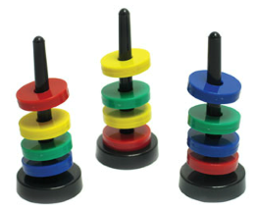
Stack
Last in First Out (LIFO)
Notes:
Data structures are ways to collect data. There are basic categories of data structures:

Slide 56
Stack ADT
Data
Items
Number of Items
Top
Operations
push(item): inserts an element
pop(): removes and returns the last inserted element
peek(): returns the last inserted element without removing it
size(): returns the number of elements stored
isEmpty(): indicates whether no elements are stored
Notes:
Data structures are ways to collect data. There are basic categories of data structures:

Slide 57
Stack Implementation - Array
Notes:
Data structures are ways to collect data. There are basic categories of data structures:

Slide 58
Stack Implementation - Array
Characteristics | Fixed Size Stores Similar Elements Access through top index
Operations | push(item) pop() peek() size() isEmpty()
Performance | push(item) – O(1) pop() - O(1) peek() - O(1) size() - O(1) isEmpty() - O(1)
Benefits
Drawbacks
Notes:
Data structures are ways to collect data. There are basic categories of data structures:

Slide 59
Stack Implementation - Array
Characteristics | Fixed Size Stores Similar Elements Access through top index
Operations | push(item) pop() peek() size() isEmpty()
Performance | push(item) – O(1) pop() - O(1) peek() - O(1) size() - O(1) isEmpty() - O(1)
Benefits
Drawbacks
Notes:
Data structures are ways to collect data. There are basic categories of data structures:

Slide 60
Stack Implementation - Array
Characteristics | Fixed Size Stores Similar Elements Access through top index
Operations | push(item) pop() peek() size() isEmpty()
Performance | push(item) – O(1) pop() - O(1) peek() - O(1) size() - O(1) isEmpty() - O(1)
Benefits
Drawbacks
Notes:
Data structures are ways to collect data. There are basic categories of data structures:

Slide 61
Stack Implementation - Array
Characteristics | Fixed Size Stores Similar Elements Access through top index
Operations | push(item) pop() peek() size() isEmpty()
Performance | push(item) – O(1) pop() - O(1) peek() - O(1) size() - O(1) isEmpty() - O(1)
Benefits
Drawbacks
Notes:
Data structures are ways to collect data. There are basic categories of data structures:

Slide 62
Stack Implementation - Array
Characteristics | Fixed Size Stores Similar Elements Access through top index
Operations | push(item) pop() peek() size() isEmpty()
Performance | push(item) – O(1) pop() - O(1) peek() - O(1) size() - O(1) isEmpty() - O(1)
Benefits
Drawbacks
Notes:
Data structures are ways to collect data. There are basic categories of data structures:

Slide 63
Stack Implementation - Array
Characteristics | Fixed Size Stores Similar Elements Access through top index
Operations | push(item) pop() peek() size() isEmpty()
Performance | push(item) – O(1) pop() - O(1) peek() - O(1) size() - O(1) isEmpty() - O(1)
Benefits | Constant time to add and remove elements
Drawbacks
Notes:
Data structures are ways to collect data. There are basic categories of data structures:

Slide 64
Stack Implementation - Array
Characteristics | Fixed Size Stores Similar Elements Access through top index
Operations | push(item) pop() peek() size() isEmpty()
Performance | push(item) – O(1) pop() - O(1) peek() - O(1) size() - O(1) isEmpty() - O(1)
Benefits | Constant time to add and remove elements
Drawbacks | Fixed size and no random access
Notes:
Data structures are ways to collect data. There are basic categories of data structures:

Slide 65
Stack Implementation – Linked List
Characteristics | Flexible Size Stores Similar Elements Access through top pointer
Operations | push(item) pop() peek() size() isEmpty()
Performance | push(item) – O(1) pop() - O(1) peek() - O(1) size() - O(1) isEmpty() - O(1)
Benefits
Drawbacks
Notes:
Add next to head

Slide 66
Stack Implementation – Linked List
Notes:
Add next to head

Slide 67
Stack Implementation – Linked List
Characteristics | Flexible Size Stores Similar Elements Access through top pointer
Operations | push(item) pop() peek() size() isEmpty()
Performance | push(item) – O(1) pop() - O(1) peek() - O(1) size() - O(1) isEmpty() - O(1)
Benefits
Drawbacks
Notes:
Add next to head

Slide 68
Stack Implementation – Linked List
Characteristics | Flexible Size Stores Similar Elements Access through top pointer
Operations | push(item) pop() peek() size() isEmpty()
Performance | push(item) – O(1) pop() - O(1) peek() - O(1) size() - O(1) isEmpty() - O(1)
Benefits
Drawbacks
Notes:
Add next to head

Slide 69
Stack Implementation – Linked List
Characteristics | Flexible Size Stores Similar Elements Access through top pointer
Operations | push(item) pop() peek() size() isEmpty()
Performance | push(item) – O(1) pop() - O(1) peek() - O(1) size() - O(1) isEmpty() - O(1)
Benefits
Drawbacks
Notes:
Add next to head

Slide 70
Stack Implementation – Linked List
Characteristics | Flexible Size Stores Similar Elements Access through top pointer
Operations | push(item) pop() peek() size() isEmpty()
Performance | push(item) – O(1) pop() - O(1) peek() - O(1) size() - O(1) isEmpty() - O(1)
Benefits
Drawbacks
Notes:
Add next to head

Slide 71
Stack Implementation – Linked List
Characteristics | Flexible Size Stores Similar Elements Access through top pointer
Operations | push(item) pop() peek() size() isEmpty()
Performance | push(item) – O(1) pop() - O(1) peek() - O(1) size() - O(1) isEmpty() - O(1)
Benefits | Constant time to add and remove elements; Variable size
Drawbacks
Notes:
Add next to head

Slide 72
Stack Implementation – Linked List
Characteristics | Flexible Size Stores Similar Elements Access through top pointer
Operations | push(item) pop() peek() size() isEmpty()
Performance | push(item) – O(1) pop() - O(1) peek() - O(1) size() - O(1) isEmpty() - O(1)
Benefits | Constant time to add and remove elements; Variable size
Drawbacks | More memory
Notes:
Add next to head

Slide 73
Stack in C++ STL
Operations | C++ STL
push(item) pop() peek() size() isEmpty() | push(g) – Adds the element ‘g’ at the top of the stack pop() – Deletes the topmost element of the stack top() – Returns a reference to the topmost element of the stack size() – Returns the size of the stack empty() – Returns whether the stack is empty
http://www.cplusplus.com/reference/stack/stack/
Notes:
Track of progress, access to current and mechanism to next data element
Dereference operator to get the data

Slide 74
Stack in C++ STL: Check Palindrome
Notes:
Track of progress, access to current and mechanism to next data element
Dereference operator to get the data

Slide 75
Stack in C++ STL: Check Palindrome
01 02 03 04 05 06 07 08 09 10 11 12 13 14 15 16 17 18 19 20 21 22 23
bool checkPalindrome(string s)
{
stack<char> stk;
int midIndex = s.length()/2;
if(s.length() < 2)
return true;
for(int i = 0; i < s.length()/2; i++)
stk.push(s.at(i));
if(s.length() % 2 != 0)
midIndex += 1;
for(int i = midIndex; i < s.length(); i++)
{
if(stk.top() != s.at(i))
return false;
stk.pop();
}
return true;
}
Base case to return true if string has one letter or is an empty string
Pushes first half of string characters on stack
Ignores central element if the size of string is odd
Prints: 200 100 100 100 100
Compare each element in the second half of the string with elements pushed in the stack
https://onlinegdb.com/Hy2vC3DVD
Notes:
Track of progress, access to current and mechanism to next data element
Dereference operator to get the data

Slide 76



Stack Use Cases
Real World
Plates
Books
Pringle Chips
Computers
Function Call Stack
Evaluate Expressions
Backtracking
Balanced Parenthesis
Undo (CTRL + Z)
Back button
Notes:
Data structures are ways to collect data. There are basic categories of data structures:

Slide 77
Stack Use Cases: Call Stack
main()
{
int i=5;
foo(i);
}
foo(int j)
{ int k = j+1; bar(k); }
bar(int m)
{ …
}
Notes:
Data structures are ways to collect data. There are basic categories of data structures:

Slide 78
Stack Use Cases: Call Stack
main()
{
int i=5;
foo(i);
}
foo(int j)
{ int k = j+1; bar(k); }
bar(int m)
{ …
}
main
PC = 2 i = 5
Notes:
Data structures are ways to collect data. There are basic categories of data structures:

Slide 79
Stack Use Cases: Call Stack
main()
{
int i=5;
foo(i);
}
foo(int j)
{ int k = j+1; bar(k); }
bar(int m)
{ …
}
foo
PC = 3 j = 5
k = 6
main
PC = 2 i = 5
Notes:
Data structures are ways to collect data. There are basic categories of data structures:

Slide 80
Stack Use Cases: Call Stack
Top
main()
{
int i=5;
foo(i);
}
foo(int j)
{ int k = j+1; bar(k); }
bar(int m)
{ …
}
bar
PC = 1 m = 6
foo
PC = 3 j = 5
k = 6
main
PC = 2 i = 5
Notes:
Data structures are ways to collect data. There are basic categories of data structures:

Slide 81
Stack Use Cases: Balanced Parenthesis
Algorithm for method isBalanced
Create an empty stack of characters
Assume that the expression is balanced (balanced is true).
Set index to 0
while balanced is true and index < the expression’s length
Get the next character in the data string
if the next character is an opening parenthesis
Push it onto the stack.
else if the next character is a closing parenthesis
Pop the top of the stack
if stack was empty or its top does not match the closing parenthesis
Set balanced to false
Increment index
Return true if balanced is true and the stack is empty
Notes:
Data structures are ways to collect data. There are basic categories of data structures:

Slide 82
Stack Use Cases: Expression Evaluation
Dijkstra’s two-stack algorithm
Value: push on the value stack
Operator: push on the operator stack
Left parenthesis, ( : ignore
Right parenthesis, ) : pop operator and two values; push the result of applying that operator to the values on the value stack
Notes:
Data structures are ways to collect data. There are basic categories of data structures:

Slide 83
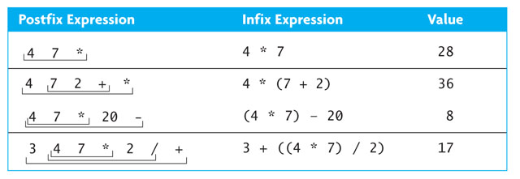
Stack Use Cases: Expression Evaluation
Postfix Expression: Removes Parenthesis
Notes:
Data structures are ways to collect data. There are basic categories of data structures:

Slide 84
Stack Use Cases: Postfix Evaluation
1. create an empty stack of integers
2. while there are more tokens
3. get the next token
4. if the first character of the token is a digit
5. push the token on the stack
6. else if the token is an operator
7. pop the right operand off the stack
8. pop the left operand off the stack
9. evaluate the operation
10. push the result onto the stack
11. pop the stack and return the result
4
4
7
*
20
-
Notes:
8

Slide 85
Stack Use Cases: Finding Palindrome
Palindrome: a string that reads identically in either direction, letter by letter
“kayak”
"I saw I was I”
“able was I ere I saw Elba”
Solve using a stack
Push each string character, from left to right, onto a stack
Pop each character off the stack, appending each to a new string
Compare the two strings
Notes:
Data structures are ways to collect data. There are basic categories of data structures:

Slide 86

Mentimeter
Menti.com
9733 1736
Notes:
Data structures are ways to collect data. There are basic categories of data structures:

Slide 87
Queues
Notes:
But what do we truly care about?

Slide 88




Queue
First in First Out (FIFO)
Notes:
Data structures are ways to collect data. There are basic categories of data structures:

Slide 89
Queue ADT
Data
Items
Number of Items
Front and Back
Operations
enqueue(item): inserts an element to the back of the queue
dequeue(): removes the element from the front
size(): returns the number of elements stored
isEmpty(): indicates whether no elements are stored
Notes:
Data structures are ways to collect data. There are basic categories of data structures:

Slide 90
Queue Implementation - Array
Characteristics | Fixed Size Stores Similar Elements Access through front index
Operations | enqueue(item) dequeue() size() isEmpty()
Performance | enqueue(item) - O(1) dequeue() - O(1) size() - O(1) isEmpty() - O(1)
Benefits | Constant time to add and remove elements
Drawbacks | Limited space Rightward drift problem
Notes:
Insertion increments back
Deletion increments front

Slide 91
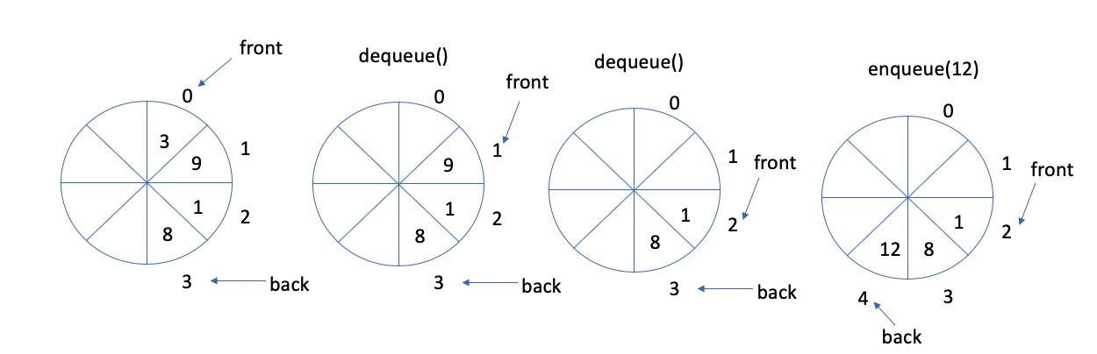
Queue Implementation – Circular Array
normal configuration
Use an array of size N in a circular fashion
Two variables keep track of the front and rear
f index of the front element
r index immediately past the rear element
Array location r is kept empty
Q
0
1
2
f
r
wrapped-around configuration
Q
0
1
2
r
f
https://stepik.org/lesson/354738/step/1?unit=338782
Notes:
Insertion increments back
Deletion increments front

Slide 92
Queue Implementation – Circular Array
Characteristics | Fixed Size Stores Similar Elements Access through front index
Operations | enqueue(item) dequeue() size() isEmpty()
Performance | enqueue(item) - O(1) dequeue() - O(1) size() - O(1) isEmpty() - O(1)
Benefits | Constant time to add and remove elements
Drawbacks | Limited space
Notes:
Insertion increments back
Deletion increments front

Slide 93
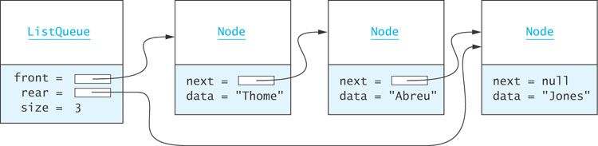
Queue Implementation – Linked List
Notes:
We can also use a linked list to implement a queue.
The ListQueue object as a reference to the front of the list and the rear of the list, and the value of the size of the list.

Slide 94
Queue Implementation – Linked List
Characteristics | Flexible Size Stores Similar Elements Access through front pointer
Operations | enqueue(item) dequeue() size() isEmpty()
Performance | enqueue(item) - O(1) dequeue() - O(1) size() - O(1) isEmpty() - O(1)
Benefits | Constant time to add and remove elements; Variable size
Drawbacks | More memory
Notes:
Add next to head

Slide 95
Queue in C++ STL
Operations | C++ STL
enqueue(item) dequeue() size() isEmpty() | push(g) – Adds the element ‘g’ at the end of the queue pop() – Deletes the first element of the queue size() – Returns the size of the queue empty() – Returns whether the queue is empty front() – Returns a reference to the first element of the queue back() – Returns a reference to the last element of the queue
http://www.cplusplus.com/reference/queue/
Notes:
Track of progress, access to current and mechanism to next data element
Dereference operator to get the data

Slide 96
Queue in C++ STL: Valid Queue
01 02 03 04 05 06 07 08 09 10 11 12 13 14 15
bool checkValidity(queue<int> q) { int temp; while(!q.empty()) { temp=q.front(); q.pop(); if(!q.empty()) { if(temp>q.front()) return false; } } return true; }
Prints: 200 100 100 100 100
https://stepik.org/lesson/354738/step/2?unit=338782
Notes:
Track of progress, access to current and mechanism to next data element
Dereference operator to get the data

Slide 97

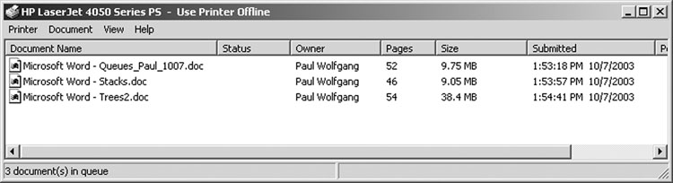
Queue Use Cases
Real World
Buying Tickets
Drive thru at fast food chains
Appointments
Computers
Print Queue
Task Scheduling by OS
Packet Forwarding by Routers
Notes:
Data structures are ways to collect data. There are basic categories of data structures:

Slide 98
Recommended Resources
http://www.cplusplus.com/reference/stl/
Stacks and Queue Questions on Stepik
OpenDSA Ch-9.8-9.14

Slide 99
Queue in C++ STL: Valid Queue
01 02 03 04 05 06 07 08 09 10 11 12 13 14 15
bool checkValidity(queue<int> q) { int temp; while(!q.empty()) { temp=q.front(); q.pop(); if(!q.empty()) { if(temp>q.front()) return false; } } return true; }
Prints: 200 100 100 100 100
https://stepik.org/lesson/354738/step/2?unit=338782
Notes:
Track of progress, access to current and mechanism to next data element
Dereference operator to get the data

Slide 100
Agenda
Announcements
Quiz Solutions (Algorithm Complexity)
Mentimeter (Stacks, Queues, Linked Lists)
Problems
Add an Element to Linked List (3.3b)
Iterators
Merge Two Lists
Median of Elements in a Linked List (3.3d)
Evaluation of Expressions using Stacks
Valid Queue (3.2b)
Notes:
Discussed, touched upon, went over, covered
Emerges out of the limitations offered by our second approach

Slide 101
Add an Element to Linked List (3.3b)
01 02 03 04 05 06 07 08 09 10 11 12 13 14 15 16 17 18 19 20 21 22 23 24 25 26 27
Node* add(Node* head, int index, int valueInput) { Node* newNode = new Node(); newNode->value = valueInput; // edge case: insert at the beginning of the linked list if (index == 0) { newNode->next = head; return newNode; } Node* curr = head; for (int i = 0; i < index - 1; i++) { if (curr != nullptr) curr = curr->next; else return nullptr; } if (curr != nullptr) { newNode->next = curr->next; curr->next = newNode; return head; } return nullptr; }
https://stepik.org/lesson/390624/step/2?unit=379724
https://onlinegdb.com/B1_T-PR4w
Notes:
Psuedocode and code
#include <iostream>class Node { public: int value; Node* next = NULL; Node() {value = 0; next = nullptr; } Node(int val, Node* node) {value = val; next = node;}};Node* add(Node* head, int index, int valueInput){ Node* newNode = new Node(); newNode->value = valueInput; // edge case: insert at the beginning of the linked list if (index == 0) { newNode->next = head; return newNode; } Node* curr = head; for (int i = 0; i < index - 1; i++) { if (curr != nullptr) curr = curr->next; else return nullptr; } if (curr != nullptr) { newNode->next = curr->next; curr->next = newNode; return head; } return nullptr;}
int main(){ Node *head, *newHead; head = new Node(0, nullptr); head->next = new Node(1, nullptr); head->next->next = new Node(2, nullptr); newHead = add(head, 1, 5);}

Slide 102
Median of Elements in a Linked List (3.3d)
Notes:
Psuedocode and code

Slide 103
Median of Elements in a Linked List (3.3d)
01 02 03 04 05 06 07 08 09 10 11 12
//runner technique, tortoise and hare float median(Node* head) { Node* fastptr = head; Node* slowptr = head; while (fastptr->next != NULL && fastptr->next->next != NULL) { slowptr = slowptr->next; fastptr = fastptr->next->next; } return fastptr->next == NULL ? slowptr->value : (slowptr->value + slowptr->next->value)/2.0; }
Prints: 200 100 100 100 100
https://stepik.org/lesson/351239/step/4?unit=335116
Notes:
Psuedocode and code

